Slide 1
Understanding Unity's Component System

Slide 2
Learning Objectives
Understand the concept of Unity's component system.
Explore common components and their roles.
Grasp the significance of component-based design in Unity.

Slide 3
What is Unity's Component System
The Entity Component System (ECS) is the core of the Unity Data-Oriented Tech Stack (DOTS). As the name indicates, ECS has three principal parts:
Entities — the entities, or things, that populate your game or program.
Components — the data associated with your entities, but organized by the data itself rather than by entity. (This difference in organization is one of the key differences between an object-oriented and a data-oriented design.)
Systems — the logic that transforms the component data from its current state to its next state— for example, a system might update the positions of all moving entities by their velocity times the time interval since the previous frame.
8: Unity Technologies, Unity Manual, 2023
Notes:
ECS is a framework / software architectural
https://docs.unity3d.com/Packages/com.unity.entities@0.17/manual/index.html

Slide 4
What is Unity's Component System
In a component system, components are mix-and-match packets of functionality, and objects are built up as a collection of components, rather than as a strict hierarchy of classes. A component system is a different (and usually more flexible) approach to object-oriented programming (OOP) that constructs game objects through composition rather than inheritance. ^{[1]}
In a component system, objects exist on a flat hierarchy, and different objects have different collections of components. An inheritance structure, in contrast, has different objects on completely different branches of the tree. The component arrangement facilitates rapid prototyping, because you can quickly mix and match components rather than having to refactor the inheritance chain when objects change.
1: Hocking, Joseph; Schell, Jesse, Unity in action: multiplatform game development in C#, 2022

Slide 5
What is Unity's Component System
Unity
Game Objects
Unity Components: Transform, MeshFilter, Renderer, Colider, Rigidbody, Script component
RenderSystem: SpriteRenderer, MeshRenderer, ParticleSystemRenderer MovingSystem: PhysicSystem: behaviour of RigidbodyComponent, ColliderComponent ...
ESC
Entity
Component
System
Notes:
Trong đồ họa máy tính, sprite là một hình ảnh hai chiều hoặc hình ảnh động được tích hợp vào một cảnh lớn hơn. Ban đầu nó chỉ bao gồm đối tượng đồ họa xử lý riêng lẻ với bộ nhớ bitmap của một màn hình video, nhưng hiện nay nó bao gồm nhiều lớp đồ họa với các sắc thái khác nhau.
GameObject là một container để “chứa” các components
Component trong Unity đều kế thừa từ class Component. Và các script mà các bạn viết kế thừa từ MonoBehaviour, cũng là class con của Component

Slide 6
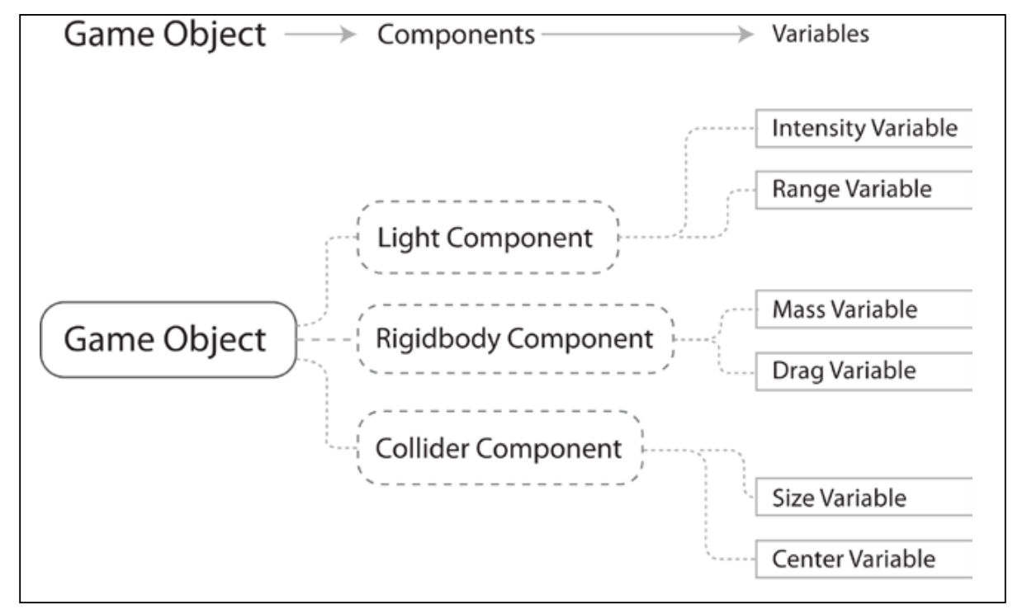
Components in Unity
In Unity, components come in various forms. They can be for creating behavior, defining appearance, and influencing other aspects of an object's function in the game.
By attaching components to an object, you can immediately apply new parts of the game engine to your object. ^{[10]}
Components are one of the three principle elements of an Entity Component System architecture. They represent the data of your game or program.^{[8]}
10: Goldstone Will, Unity 3.x game development essentials, 2011
8: Unity Technologies, Unity Manual, 2023
Notes:
https://docs.unity3d.com/Packages/com.unity.entities@0.1/manual/ecs_components.html
Components are the actual data containers. They are structs that hold values without any logic, and you’ll no doubt have a lot of them. ECS revolves around storing these small Components in a clever way.
https://www.kodeco.com/7630142-entity-component-system-for-unity-getting-started
https://docs.unity3d.com/ScriptReference/Component.html

Slide 7
Components in Unity
Common components of game production come built-in with Unity, such as the Rigidbody component mentioned earlier, down to simpler elements such as lights, cameras, particle emitters, and more ^{[10]}
To build further interactive elements of the game, you'll write scripts, which are also treated as components in Unity. Try to think of a script as something that extends or modifies the existing functionality available in Unity or creates behavior with the Unity
scripting classes provided. ^{[10]}

Slide 8
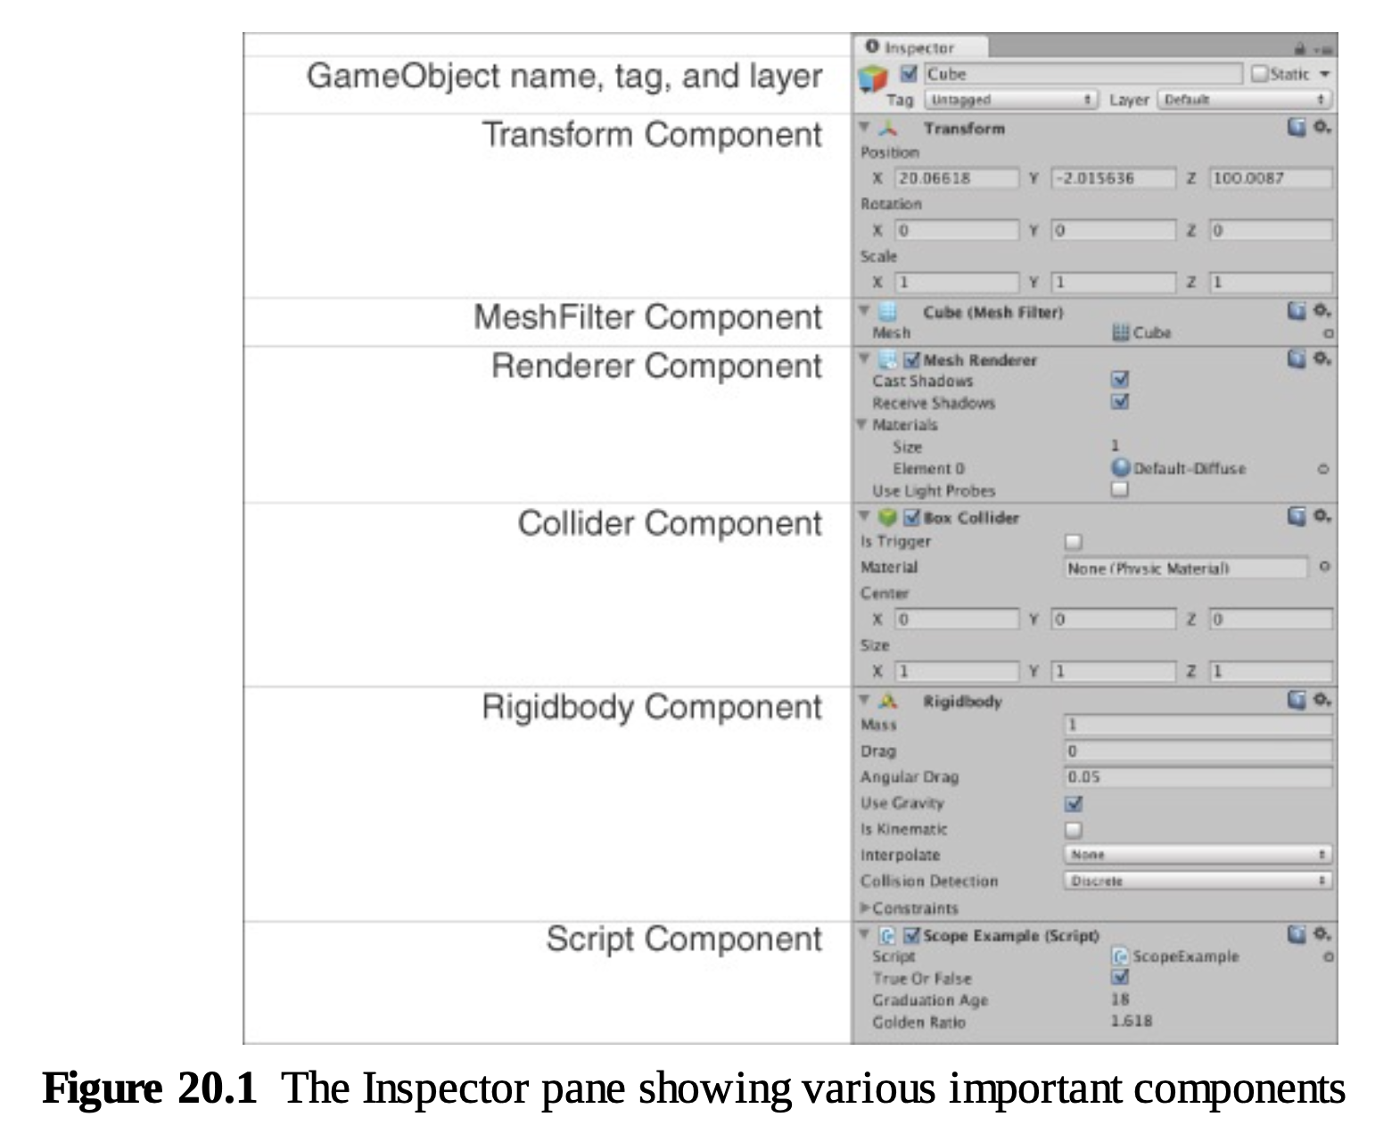
Common Components in Unity
Components | Using / Datastore
Transform | Position, Rotation, scale
Renderer | Object appear on the screen
Collider | Define the shape of an object for the purposes of physical collisions
Rigidbody | Enables GameObject to be controlled by Unity's physics engine, including gravity, collisions, forces, and realistic physical behavior
Script | All code execution in Unity starts from code files linked to an object in the scene Scripts in Unity are more akin to individual OOP classes, and scripts attached to objects in the scene are object instances ^{[1]}
6: Gibson Bond, Jeremy, Introduction to Game Design, Prototyping, and Development: From Concept to Playable Game with Unity and C,
Notes:
https://docs.unity3d.com/ScriptReference/Renderer.html
https://docs.unity3d.com/560/Documentation/Manual/CollidersOverview.html
https://docs.unity3d.com/ScriptReference/Rigidbody.html

Slide 9
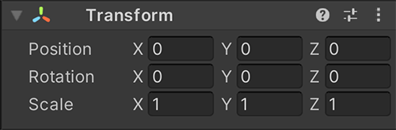
The Transform Component
Transform: Position, Rotation, and Scale
Transform is a mandatory component that is present on all GameObjects. Transform handles critical GameObject information like position (the location of the GameObject), rotation (the orientation of the GameObject), and scale (the size of the GameObject). Though the information is displayed in the Inspector pane, Transform is also responsible for the parent/child relationships in the Hierarchy pane. When one object is the child of another, it moves with that parent object as if attached to it.
6: Gibson Bond, Jeremy, Introduction to Game Design, Prototyping, and Development: From Concept to Playable Game with Unity and C,
Notes:
https://docs.unity3d.com/Manual/class-Transform.html

Slide 10
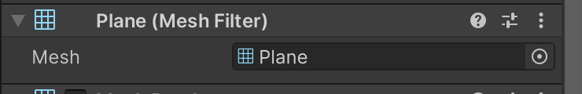
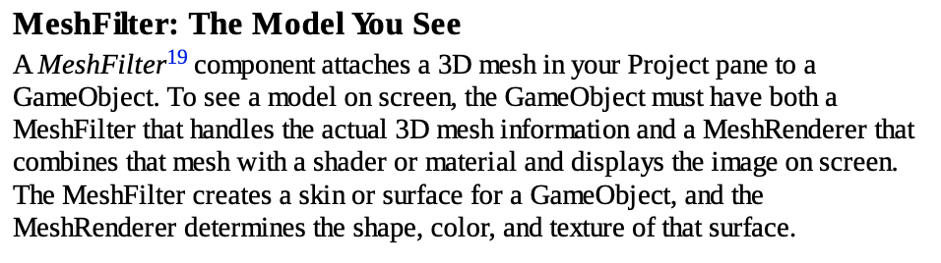
The MeshFilter Component
6: Gibson Bond, Jeremy, Introduction to Game Design, Prototyping, and Development: From Concept to Playable Game with Unity and C,
Notes:
https://docs.unity3d.com/Manual/class-MeshFilter.html
MeshFilter: Chứa dữ liệu hình học (geometry) của đối tượng - tức là thông tin về các đỉnh (vertices), tam giác (triangles), UV mapping. MeshRenderer: Bộ kết xuất Mesh: Render (vẽ) mesh lên màn hình, sử dụng materials và shaders để tạo ra hình ảnh cuối cùng.

Slide 11
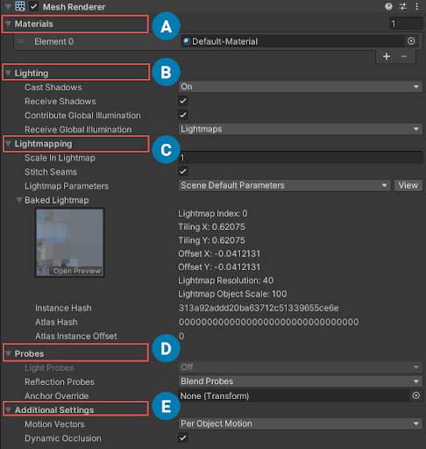
The Renderer Component
Renderer: Allows You to See the GameObject
A Renderer component—in most cases, a MeshRenderer—allows you to see the GameObject in the Scene and Game panes. The MeshRenderer requires a MeshFilter to provide 3D mesh data as well as at least one Material if you want it to look like anything other than an ugly magenta blob (Materials apply textures to objects, and when no Material is present, Unity defaults to solid magenta to alert you to the problem). Renderers bring the MeshFilter, the Material(s), and lighting together to show the GameObject on screen.
6: Gibson Bond, Jeremy, Introduction to Game Design, Prototyping, and Development: From Concept to Playable Game with Unity and C,
Notes:
https://docs.unity3d.com/Manual/class-MeshRenderer.html
Chức năng: Render (vẽ) mesh lên màn hình, sử dụng materials và shaders để tạo ra hình ảnh cuối cùng.

Slide 12
The Rigdbody Component
Rigidbody: The Physics Simulation
The Rigidbody component controls the physics simulation of your GameObject. The Rigidbody component simulates acceleration and velocity every FixedUpdate (generally every 50th of a second) to update the position and rotation of the Transform component over time. It also uses the Collider component to handle collisions with other GameObjects. The Rigidbody component can also model things like gravity, drag, and various forces like wind and explosions. Set isKinematic to true if you want to directly set the position of your GameObject without using the physics provided by Rigidbody.
6: Gibson Bond, Jeremy, Introduction to Game Design, Prototyping, and Development: From Concept to Playable Game with Unity and C,
Notes:
https://docs.unity3d.com/Manual/class-Rigidbody.html

Slide 13
Rigidbody
Rigidbody trong Unity là thành phần dùng để thêm vật lý cho GameObject. Nó giúp GameObject bị ảnh hưởng bởi các lực như trọng lực, va chạm, và gió.
Các điểm chính:
Trọng lực (Gravity): Làm GameObject rơi xuống.
Lực kéo (Drag): Làm chậm chuyển động.
Va chạm: Làm việc với Collider để xử lý va chạm.
isKinematic: Tắt vật lý tự động, bạn tự kiểm soát chuyển động qua mã.
Nói ngắn gọn, Rigidbody biến GameObject thành một vật thể "sống" trong thế giới vật lý.

Slide 14
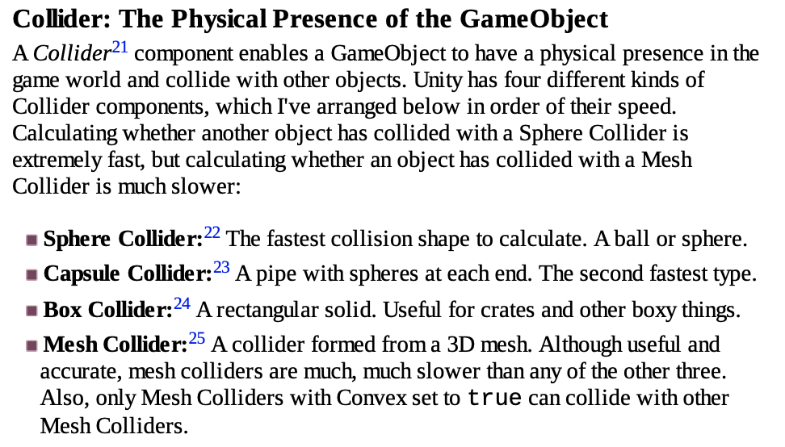
The Collider Component
6: Gibson Bond, Jeremy, Introduction to Game Design, Prototyping, and Development: From Concept to Playable Game with Unity and C,
Notes:
https://docs.unity3d.com/Manual/collision-section.html
Collider: Thành phần định nghĩa vùng va chạm và tương tác vật lý của đối tượng.
MeshFilter: Thành phần chứa dữ liệu hình học (mesh) của đối tượng 3D.
MeshRenderer: Thành phần hiển thị mesh lên màn hình với materials và textures.
Rigidbody: Thành phần cho phép đối tượng tương tác với hệ thống vật lý Unity.

Slide 15
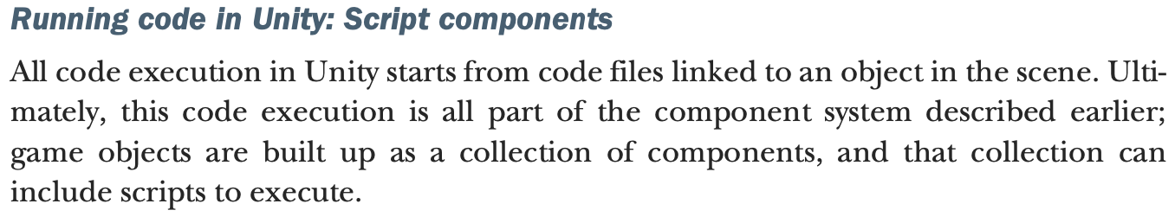
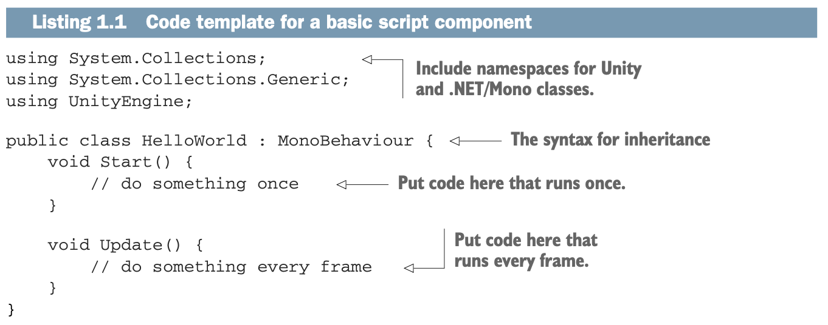
Script Components
1: Hocking, Joseph; Schell, Jesse, Unity in action: multiplatform game development in C#, 2022

Slide 16
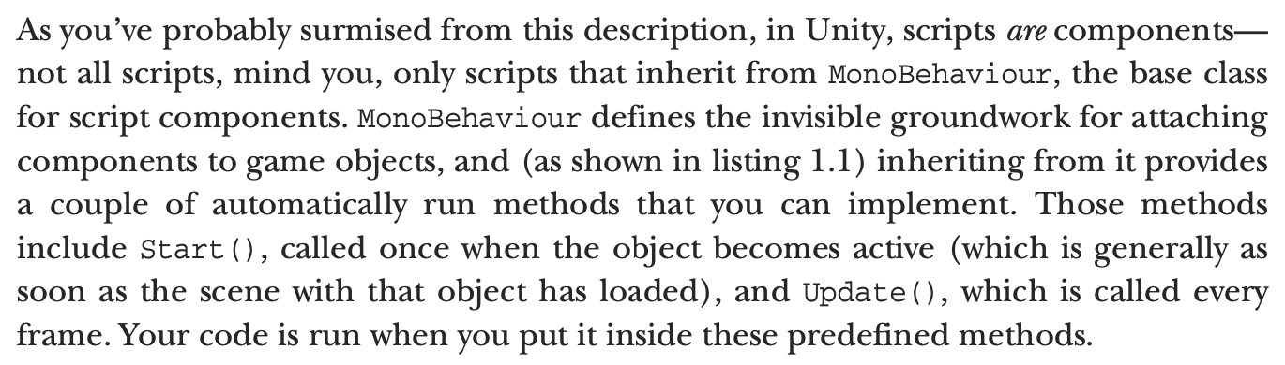
Script Components
1: Hocking, Joseph; Schell, Jesse, Unity in action: multiplatform game development in C#, 2022

Slide 17
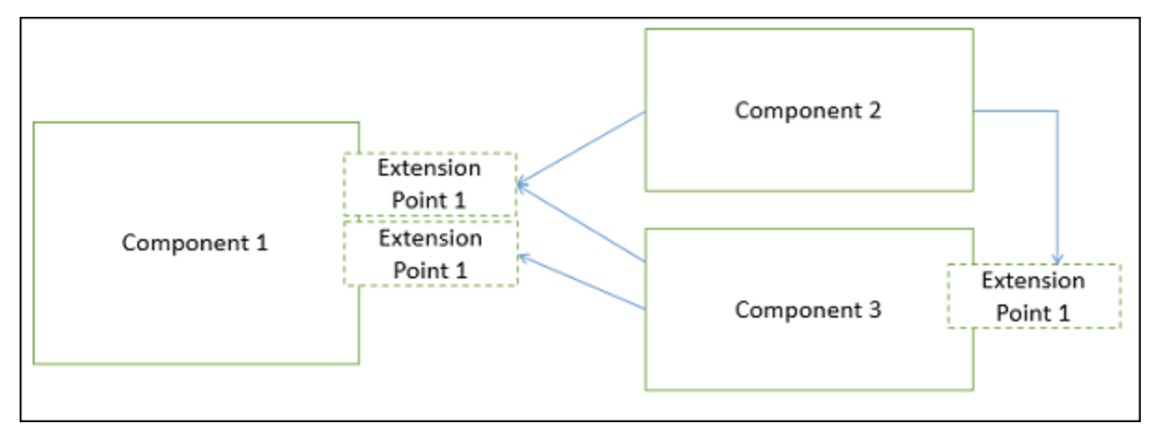
Advantages of Component-Based Design (CBD)
There are many advantages of developing the applications using the CBD
Ease of deployment − As new compatible versions become available, it is easier to replace existing versions with no impact on the other components or the system as a whole.
2.Reduced cost − The use of third-party components allows you to spread the cost of development and maintenance.
Ease of development − Components implement well-known interfaces to provide defined functionality, allowing development without impacting other parts of the system.
4. Reusable − The use of reusable components means that they can be used to spread the development and maintenance cost across several applications or systems.

Slide 18
Advantages of Component-Based Design (CBD)
Modification of technical complexity − A component modifies the complexity through the use of a component container and its services.
6. Reliability − The overall system reliability increases since the reliability of each individual component enhances the reliability of the whole system via reuse.
7. System maintenance and evolution − Easy to change and update the implementation without affecting the rest of the system.
8. Independent − Independency and flexible connectivity of components. Independent development of components by different group in parallel. Productivity for the software development and future software development.

Slide 19
Practice 1 – Simple Unity Animation and Scripting
Project Setup
Create a new Unity project using Unity Hub
Choose "3D Core" as the template
Name it "SimpleAnimationExample"
Set up the scene
In the Hierarchy window, right-click and select 3D Object > Cube
Name it "InteractiveCube"
Position it at (0, 0, 0) in the Scene view
Rick Davidson, Complete C# Unity Game Developer 2D, 2023

Slide 20
Practice 1 – Simple Unity Animation and Scripting
Creating the Animation
Create an Animation
Select the cube in the Hierarchy
Open the Animation window (Window > Animation > Animation)
Click "Create" and save the animation as "CubeFloat"
The Animation window will open
Record the floating animation
a. Initial Setup (0 seconds):
Make sure the red recording button is enabled in the Animation window
In the timeline at the bottom of the Animation window, move the playhead to 0:00
In the Scene view or Inspector, ensure the cube's Transform position is at Y = 0
Click the Add Property button in the Animation window
Navigate to Transform > Position > Y
A diamond-shaped keyframe marker will appear at 0:00 in the timeline
Rick Davidson, Complete C# Unity Game Developer 2D, 2023

Slide 21
Practice 1 – Simple Unity Animation and Scripting
b. Middle Position (1 second):
Move the timeline playhead to 1:00 (click on the timeline or drag the playhead)
In the Scene view, drag the cube up to Y = 2
Alternatively, in the Inspector, set the Y position to 2
Unity will automatically create a keyframe at 1:00
c. Final Position (2 seconds): Move the timeline playhead to 2:00
Move the cube back down to Y = 0 in the Scene view
Or set Y = 0 in the Inspector
A final keyframe will be created automatically
Rick Davidson, Complete C# Unity Game Developer 2D, 2023

Slide 22
Practice 1 – Simple Unity Animation and Scripting
d. Verifying the Animation:
Click the Play button in the Animation window (not the main Unity Play button)
You should see the curve in the Animation window showing a smooth up-and-down motion
In the Scene view, you can see the cube preview moving up and down
3. Configure the Animation
Select the animation clip in the Project window
In the Inspector, set:
Loop Time: Enabled
Loop Pose: Enabled
Rick Davidson, Complete C# Unity Game Developer 2D, 2023

Slide 23
Practice 1 – Creating the Script
Create a new script
In the Project window, right-click > Create > C# Script
Name it "CubeController"
Attach it to the cube by dragging it onto the cube in the Hierarchy
Open the script and replace its contents with: [In this slide notes]
Testing the Project
Press the Play button in the Unity Editor
You should see:
The cube floating up and down continuously
The cube changing color each time you click it
Rick Davidson, Complete C# Unity Game Developer 2D, 2023
Notes:
using UnityEngine;
public class CubeController : MonoBehaviour // Make sure there's no space between MonoBehaviour and the curly brace
{
private Renderer cubeRenderer;
private Color[] colors = new Color[]
{
Color.red,
Color.blue,
Color.green,
Color.yellow
};
private int currentColorIndex = 0;
void Start()
{
// Get the renderer component
cubeRenderer = GetComponent<Renderer>();
// Set initial color
cubeRenderer.material.color = colors[currentColorIndex];
}
void OnMouseDown()
{
// Change to next color when clicked
currentColorIndex = (currentColorIndex + 1) % colors.length;
cubeRenderer.material.color = colors[currentColorIndex];
}
}

Slide 24
Practice 1 – How It Works
Animation: The animation system interpolates the cube's position between the keyframes we set, creating smooth movement
Script:
Start(): Runs when the object is initialized, gets the renderer component and sets initial color
OnMouseDown(): Unity's built-in function that runs when the object is clicked
The color array and index create a cycle of colors that changes on each click
Rick Davidson, Complete C# Unity Game Developer 2D, 2023

Slide 25
Conclusions
Understanding Unity's Component System: Explored the modular approach where components encapsulate entity functionalities.
Exploration of Common Components: Introduced vital components like Transform, Renderer, Collider, Rigidbody, and Scripts, elucidating their roles and importance.
Component-Based Design Advantages: Discussed the benefits—reusability, modularity, extensibility — of this design approach.

Slide 26
References
1: Hocking, Joseph; Schell, Jesse, Unity in action: multiplatform game development in C#, 2022
3: Geig, Mike, Sams teach yourself Unity Game development in 24 hours, 2014
6: Gibson Bond, Jeremy, Introduction to Game Design, Prototyping, and Development: From Concept to Playable Game with Unity and C,
8: Unity Technologies, Unity Manual, 2023
9: Tutorials Point, Learning Unity, 2023
10: Goldstone Will, Unity 3.x game development essentials, 2011

